Slide 1
Learning Objective
I will be able to differentiate $x^{n}$ when n is a non-zero integer
Success Criteria
At the end of the lesson, I will be able to:
Apply the rules of derivative to differentiate functions.

Slide 2





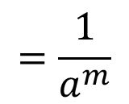




Index Laws
Activating Prior Knowledge
$$a^{m}×a^{n}$$
$$=a^{m+n}$$
$$a^{m}÷a^{n}$$
$$=a^{m−n}$$
$${\left(a^{m}\right)}^{n}$$
$$=a^{mn}$$
$${\left(ab\right)}^{m}$$
$$=a^{m}b^{m}$$
$$=\frac{1}{a^{m}}$$
$$a^{−m}$$

Slide 3







Rules of Derivative
Concept Development
$$f(x)$$ | $$f′(x)$$
$$x^{1}$$
$$x^{2}$$
$$x^{3}$$
$$x^{4}$$
$$x^{5}$$
$$⋮$$
$$x^{n}$$
$$1$$
$$2x$$
$$3x^{2}$$
$$4x^{3}$$
$$5x^{4}$$
$$nx^{n−1}$$

Slide 4

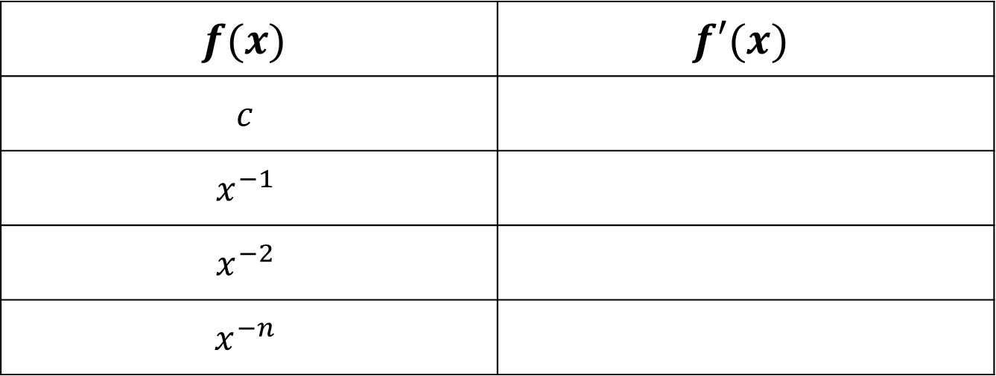



Rules of Derivative
Concept Development
$$f(x)$$ | $$f′(x)$$
$$c$$
$$x^{−1}$$
$$x^{−2}$$
$$x^{−n}$$
$$0$$
$$\left(−1\right)x^{−2}={−x}^{−2}$$
$$\left(−2\right)x^{−3}=−2x^{−3}$$
$$\left(−n\right)x^{−n−1}=−nx^{−n−1}$$

Slide 5
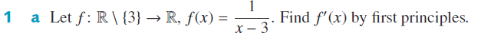
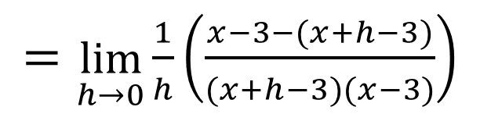
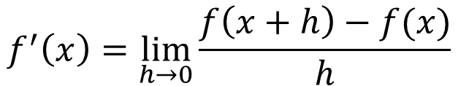
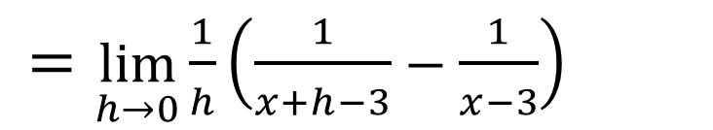
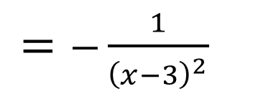
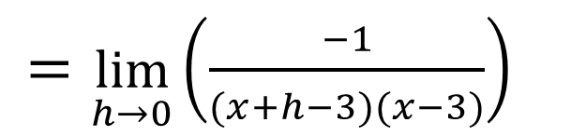
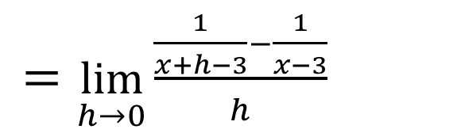
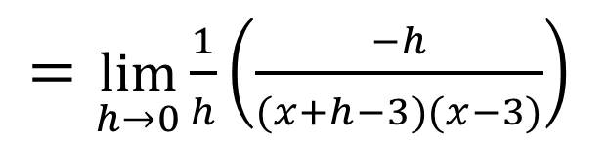
Guided Practice
Recall, first principles of derivatives
$$f^{′}\left(x\right)=\lim_{h→0}{\frac{f\left(x+h\right)−f(x)}{h}}$$
$=\lim_{h→0}{\frac{\frac{1}{x+h−3}−\frac{1}{x−3}}{h}}$
$=\lim_{h→0}{\frac{1}{h}\left(\frac{1}{x+h−3}−\frac{1}{x−3}\right)}$
$=\lim_{h→0}{\frac{1}{h}\left(\frac{x−3−(x+h−3)}{(x+h−3)(x−3)}\right)}$
$=\lim_{h→0}\left(\frac{−1}{(x+h−3)(x−3)}\right)$
$=\lim_{h→0}{\frac{1}{h}\left(\frac{−h}{(x+h−3)(x−3)}\right)}$
$=−\frac{1}{{\left(x−3\right)}^{2}}$

Slide 6
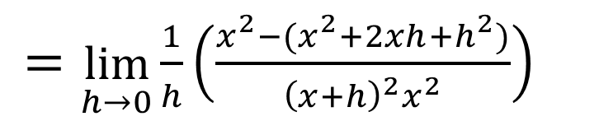
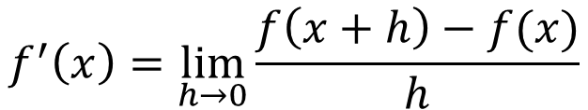
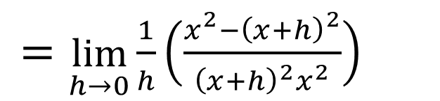
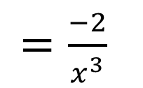
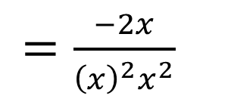
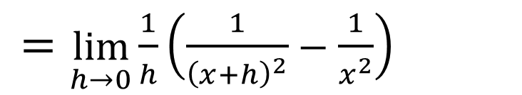
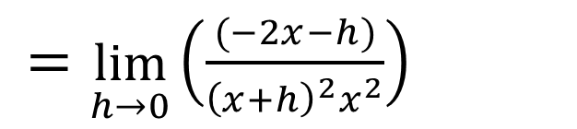
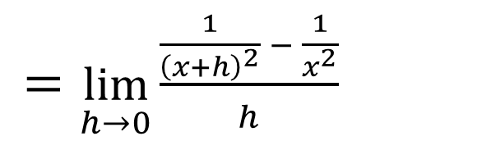
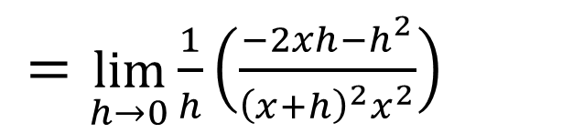
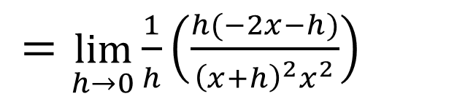
Guided Practice
Recall, first principles of derivatives
$$f^{′}\left(x\right)=\lim_{h→0}{\frac{f\left(x+h\right)−f(x)}{h}}$$
$=\lim_{h→0}{\frac{\frac{1}{{\left(x+h\right)}^{2}} − \frac{1}{x^{2}}}{h}}$
$=\lim_{h→0}{\frac{1}{h}\left(\frac{−2xh−h^{2}}{{\left(x+h\right)}^{2}x^{2}}\right)}$
$=\lim_{h→0}{\frac{1}{h}\left(\frac{1}{{\left(x+h\right)}^{2}}−\frac{1}{x^{2}}\right)}$
$=\lim_{h→0}{\frac{1}{h}\left(\frac{h(−2x−h)}{{\left(x+h\right)}^{2}x^{2}}\right)}$
$=\lim_{h→0}{\frac{1}{h}\left(\frac{x^{2}−{\left(x+h\right)}^{2}}{{\left(x+h\right)}^{2}x^{2}}\right)}$
$=\lim_{h→0}\left(\frac{(−2x−h)}{{\left(x+h\right)}^{2}x^{2}}\right)$
$=\lim_{h→0}{\frac{1}{h}\left(\frac{x^{2}−(x^{2}+2xh+h^{2})}{{\left(x+h\right)}^{2}x^{2}}\right)}$
$=\frac{−2x}{{\left(x\right)}^{2}x^{2}}$
$=\frac{−2}{x^{3}}$

Slide 7

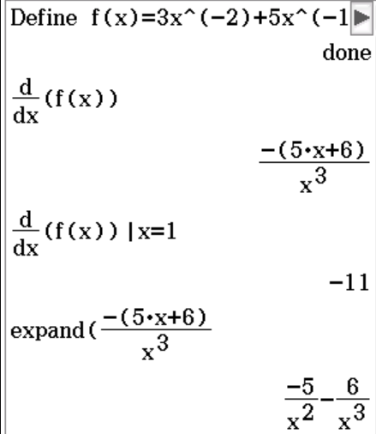

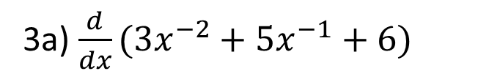

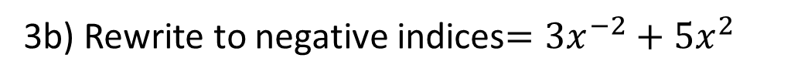



Guided Practice
3a) $\frac{d}{dx}(3x^{−2}+5x^{−1}+6)$
3b) Rewrite to negative indices$={3x}^{−2}+5x^{2}$
$$=3\left(−2\right)x^{−3}+5\left(−1\right)x^{−2}$$
$$\frac{d}{dx}({3x}^{−2}+5x^{2})$$
$$f^{′}\left(x\right)=−6x^{−3}−5x^{−2}$$
$$=3\left(−2\right)x^{−3}+5\left(2\right)x$$
$$=−6x^{−3}+10x$$

Slide 8

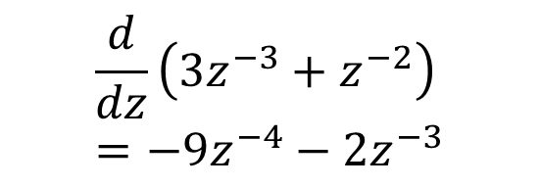
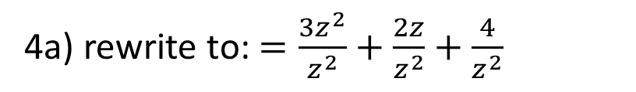

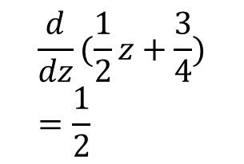
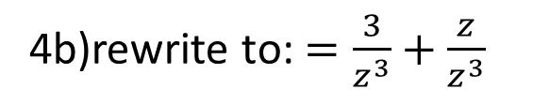


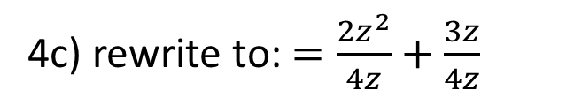
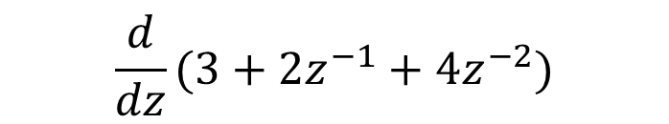
Guided Practice
4a) rewrite to: $=\frac{3z^{2}}{z^{2}}+\frac{2z}{z^{2}}+\frac{4}{z^{2}}$
4c) rewrite to: $=\frac{2z^{2}}{4z}+\frac{3z}{4z}$
$$\frac{d}{dz}(3+2z^{−1}+4z^{−2})$$
$$=\frac{1}{2}z+\frac{3}{4}$$
$$=−2z^{−2}−8z^{−3}$$
4b)rewrite to: $=\frac{3}{z^{3}}+\frac{z}{z^{3}}$
$$\frac{d}{dz}(\frac{1}{2}z+\frac{3}{4})=\frac{1}{2}$$
$$=3z^{−3}+z^{−2}$$
$$\frac{d}{dz}\left(3z^{−3}+z^{−2}\right)=−9z^{−4}−2z^{−3}$$

Slide 9
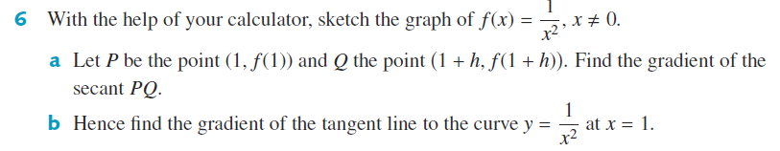
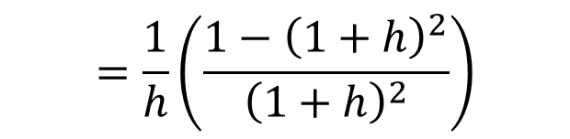
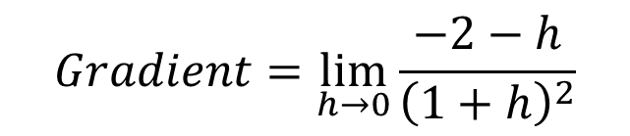
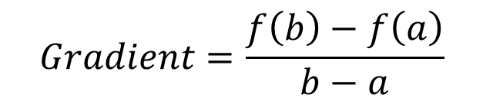
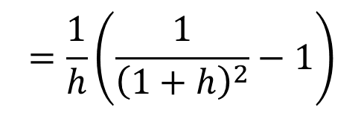
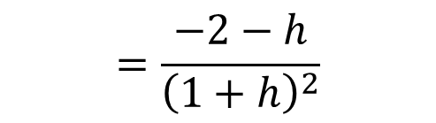
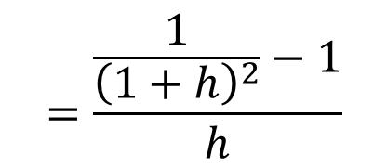
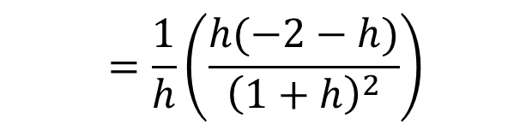
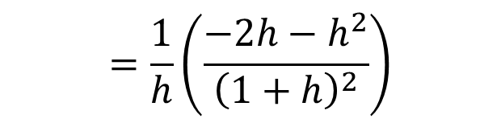
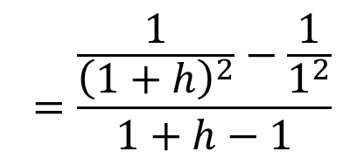
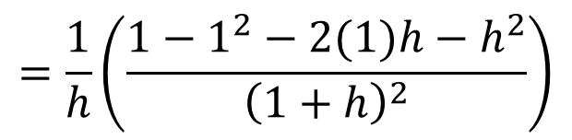

Guided Practice
6a) Recall
$$Gradient=\frac{f\left(b\right)−f\left(a\right)}{b−a}$$
$$=\frac{1}{h}\left(\frac{1−1^{2}−2(1)h−h^{2}}{{\left(1+h\right)}^{2}}\right)$$
$$=\frac{\frac{1}{{\left(1+h\right)}^{2}}−\frac{1}{1^{2}}}{1+h−1}$$
6b)
$$Gradient=\lim_{h→0}{\frac{−2−h}{{\left(1+h\right)}^{2}}}$$
$$=\frac{1}{h}\left(\frac{−2h−h^{2}}{{\left(1+h\right)}^{2}}\right)$$
$$=\frac{\frac{1}{{\left(1+h\right)}^{2}}−1}{h}$$
$$=\frac{1}{h}\left(\frac{h(−2−h)}{{\left(1+h\right)}^{2}}\right)$$
$$=−2$$
$$=\frac{1}{h}\left(\frac{1}{{\left(1+h\right)}^{2}}−1\right)$$
$$=\frac{−2−h}{{\left(1+h\right)}^{2}}$$
$$=\frac{1}{h}\left(\frac{1−{\left(1+h\right)}^{2}}{{\left(1+h\right)}^{2}}\right)$$

Slide 10
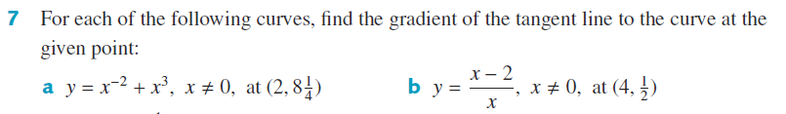



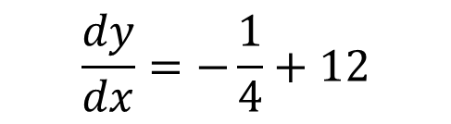

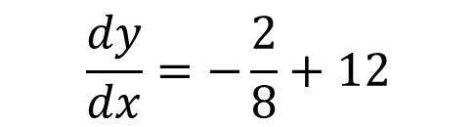

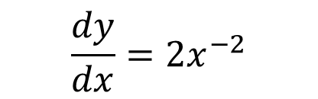


Guided Practice
$$\frac{dy}{dx}=−2x^{−3}+3x^{2}$$
$$y=1−2x^{−1}$$
Subst x = 2 , $\frac{dy}{dx}=−2{\left(2\right)}^{−3}+3{\left(2\right)}^{2}$
$$\frac{dy}{dx}=2x^{−2}$$
$$\frac{dy}{dx}=−\frac{2}{8}+12$$
Subst x = 4 , $\frac{dy}{dx}=2{\left(4\right)}^{−2}$
$$\frac{dy}{dx}=−\frac{1}{4}+12$$
$$\frac{dy}{dx}=\frac{2}{16}$$
$$\frac{dy}{dx}=11\frac{3}{4}$$
$$\frac{dy}{dx}=\frac{1}{8}$$

Slide 11
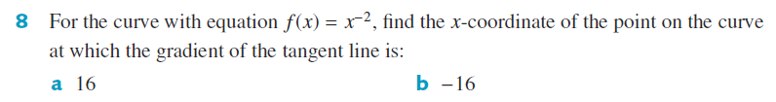











Guided Practice
$$f^{′}\left(x\right)=−2x^{−3}$$
When gradient of tangent =16, $f^{′}\left(x\right)=16$. Solve for x
$$−2x^{−3}=16$$
When gradient of tangent =16, $f^{′}\left(x\right)=−16$. Solve for x
$$x^{−3}=−8$$
$$−2x^{−3}=−16$$
$$\frac{1}{x^{3}}=−8$$
$$x^{−3}=8$$
$$\frac{1}{x^{3}}=8$$
$$x^{3}=−\frac{1}{8}$$
$$x^{3}=\frac{1}{8}$$
$$x=−\frac{1}{2}$$
$$x=\frac{1}{2}$$

Slide 12

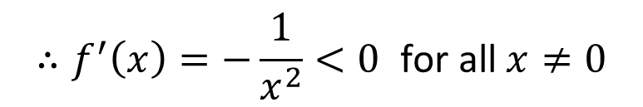
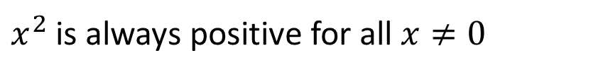

Guided Practice
$$f^{′}\left(x\right)=−x^{−2}$$
$$f^{′}\left(x\right)=−\frac{1}{x^{2}}$$
$x^{2}$ is always positive for all $x≠0$
$${∴f^{′}\left(x\right)=−\frac{1}{x^{2}}<0}^{ }\text{for} \text{all} x≠0$$

Slide 13
Independent Practice
Complete Cambridge Ex 17E

